Slide 1
Fundamentals of Database
Unit 9

Slide 2
Data:
Data are the raw facts about person, place, thing. Data is meaningless, but when we process data it will give meaning. Data is not arranged.
Eg eats ram apple everyday.

Slide 3
Information:
The processed data is called information. It is meaningful and arranged.
Eg ram eats apple everyday.

Slide 4
File-Oriented Approach and Database Approach
In the early days, data was stored in files. For an application, multiple files are required to be created. Each file stores and maintains its own related data. For example, a student information system would include files like student profile, student course, student result, student fees etc. However, there are many drawbacks of using the file system, as discussed below—
Data redundancy – It means storing the same data at multiple locations.
Data inconsistency- It means having different data values for the common fields in different files.
The files in which the data is stored can have different file formats.
Adding new constraints or changing an existing one becomes difficult.
The files can be accessed concurrently by multiple users. For example, two users may try to update the data in a file at the same time.

Slide 5
Database approach provides solutions for handling the problems of the file system approach:
Data Redundancy is Minimized- Database system keeps data at one place in the database.
Data Inconsistency is Reduced- Minimizing data redundancy using database system reduces data inconsistency too.
Data is Shared- Data sharing means sharing the same data among more than one user.
Data Independence-It is the separation of data description (metadata) from the application programs that use the data.
Data Integrity is Maintained-Stored data is changed frequently for variety of reasons such as adding new data item types, and changing the data formats.
Data Security is Improved.
Backup and Recovery Support.
Standards are Enforced-Since the data is stored centrally, it is easy to enforce standards on the database.
Application Development Time is Reduced-The database approach greatly reduces the cost and time for developing new business applications.

Slide 6
Database:
The organized collection of related data which is used for various purpose is called database.
Eg Telephone directory, dictionary, mark ledger etc.

Slide 7
Data Models, Schema and Instances
The data model describes the structure of the database. A data model consists of components for describing the data, the relationships among them, and the semantics of data and the constraints (condition) that hold data. The data models are generally divided into three categories as follows:
High level or conceptual Data Model
Representation or implementation Data Model
Low level or physical Data Model
Schema is the logical structure of the database. A schema contains information about the descriptions of the database like the names of the record type, the data items within a record type, and constraints. A schema does not show the data in the database. The database schema does not change frequently. Instances are the actual data contained in the database at a particular point of time. The content of the database may change from time to time.

Slide 8
High-Level or Conceptual Data Model
The conceptual data model is a description of the data requirements of the user. This model is not concerned with the implementation details. It ensures that all the functional and data requirements of the users are specified, conceptually. The conceptual model is defined using terms like (1) Entity, (2) Attribute, and (3) Relationship. The Entity-Relationship model (E-R model) is an example of conceptual data model.
Entity-An entity is the basic unit for modeling. It is a real-world object that exists physically or conceptually. An entity that exists physically is a tangible object like student, employee, room, machine, part or supplier. An object that exists conceptually is a non-tangible object like an event or job title. For e.g. student information system may consist of entities like student _profile, marks and course.

Slide 9
Attribute- An attribute describes some property or characteristics of the entity. For e.g. student name, student address, and student age are attributes of the entity student_profile. Diagrammatically, an attribute is represented as an ellipse connected to the entity with a line.
Relationship- An association or link between two entities is represented using a relationship. The different relationship are of four kinds—(1) One-to-One, (2) One-to-Many, (3) Many-to One, and (4) Many-to-Many.

Slide 10
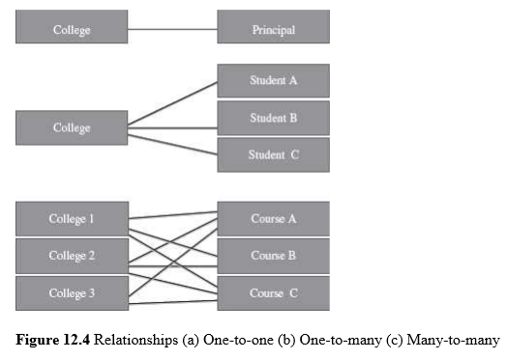

Slide 11
Entity-Relationship (E-R) Model
E-R model is a model of the real world. E-R model represents the entities contained in the database. The entities are further described in the database using attributes. The relation between the entities is shown using the relationships. The E-R model is represented diagrammatically using an E-R diagram. Figure below shows a simple E-R diagram. The diagram shows two entities—Student and Course. The Stud_Name and Stud_RollNo are the attributes of the entity Student. The Course_Id and Course_Name are the attributes of the entity Course. The Admission relationship associates the student with the course. Database design in E-R model is converted to design in the Representation Model which is used for storage and processing.

Slide 12
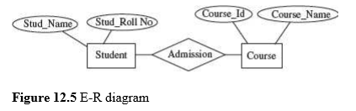
Fig E-R diagram

Slide 13
Representation or Implementation Data Model
The Conceptual Data Model is transformed into the Representation Data Model. Representation data model uses concepts that are understood by the end-user and are also close to the way the data is organized in the computer. These models hide the details of data storage. The data models are broadly classified as —
(1) Relational data models
(2)Hierarchical data models
(3) Network data models.

Slide 14
Relational Database Model
The Relational Database Model was proposed in 1970 by E. F. Codd. Relational database model is the most common type of database model in which data are arranged in two dimensional tables which are made of columns and rows. Table, record, field, key, and data values are the terms associated with a relational model. In this model each column represent a field ,also called attribute and each row represent a record, called tuple. The relationship between the two tables is implemented through a common attribute in the table not by physical links. Relational models are popular way of organizing data for business needs because of their flexibility. Several commercial products like DB2, ORACLE, SQL SERVER etc are relational database.

Slide 15
Advantages of Relational Database model:
Support to Operations Based on Set Theory- Basically, relational databases are based on relational set theory. Normalization is a vital component of the relational model of databases.
Dynamic Views- Changing the data in a table alters the data depicted by the view.
Simple Operations and Defined Relationships-Relational databases use SQL, which is an easy and human-readable language.
Security:-Relational databases provide excellent security. They support access permissions which allow the database administrator to implement need-based permissions to the access of data in database tables.
The other important advantages of relational databases include their performance, power, and support to new hardware technologies, as also flexibility and a capacity to meet all types of data needs.

Slide 16
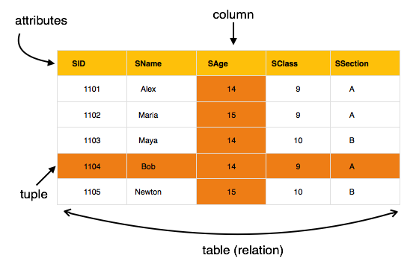
Fig Relational model

Slide 17
2) Hierarchical model
This database model organizes data into a tree-like-structure, with a single root, to which all the other data is linked. The hierarchy starts from the Root data, and expands like a tree, adding child nodes to the parent nodes.
In this model, a child node will only have a single parent node.
This model efficiently describes many real-world relationships like index of a book, recipes etc.
In hierarchical model, data is organized into tree-like structure with one-to-many relationship between two different types of data, for example, one department can have many courses, many professors and of-course many students.

Slide 18
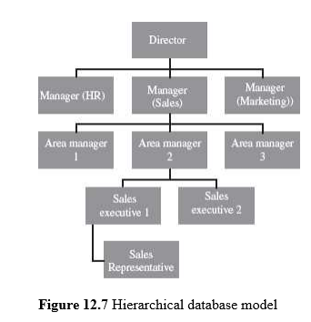

Slide 19
3) Network Model
This is an extension of the Hierarchical model. This model allowed to have more than one parent node.
In this database model data is more related as more relationships are established in this database model. Also, as the data is more related, hence accessing the data is also easier and fast. This database model was used to map many-to-many data relationships.
This was the most widely used database model, before Relational Model was introduced.
The hierarchical model is simple to construct. However, the network model is able to handle complex relationships easily. Both hierarchical and network models are also called outdated models as most current systems support the Relational Model.

Slide 20
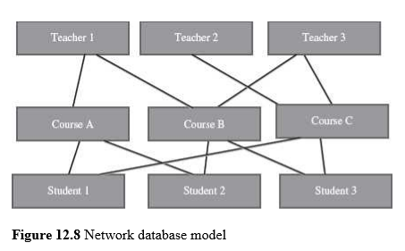

Slide 21
DBMS
A database management system (DBMS) is a software for creating and managing databases. The DBMS provides users with a systematic way to create, retrieve, update and manage data.
The DBMS essentially serves as an interface between the database and end users , ensuring that data is consistently organized and remains easily accessible.

Slide 22
objectives of DBMS
1. Eliminate redundant data.
2. Make access to the data easy for the user.
3. Provide for mass storage of relevant data.
4. Protect the data from physical harm and un-authorised systems.
5. Allow for growth in the data base system.
6. Make the latest modifications to the data base available immediately.
7. Allow for multiple users to be active at one time.
8. Provide prompt response to user requests for data.

Slide 23
Function of DBMS:
Data Redundancy is Minimized- Database system keeps data at one place in the database.
Data Inconsistency is Reduced- Minimizing data redundancy using database system reduces data inconsistency too.
Data is Shared- Data sharing means sharing the same data among more than one user.
Data Independence-It is the separation of data description (metadata) from the application programs that use the data.
Data Integrity is Maintained-Stored data is changed frequently for variety of reasons such as adding new data item types, and changing the data formats.
Data Security is Improved.
Backup and Recovery Support.
Standards are Enforced-Since the data is stored centrally, it is easy to enforce standards on the database.
Application Development Time is Reduced-The database approach greatly reduces the cost and time for developing new business applications.

Slide 24
Disadvantages of DBMS:
1. Complexity of backup and recovery
2. Difficult to get skilled Manpower of DBMS.
3. Cost of software, hardware .

Slide 25
Data Dictionary
Data dictionary contains metadata, i.e. data about the data. Metadata is the data that describe the properties or characteristics of other data. Eg index of book.

Slide 26
Database Administrator
DBA is a person or a group of persons who manages the data, determine the content, internal structure of Database and access strategy for a database.
DBA is responsible for creating, modifying and maintaining the DBMS

Slide 27
Function of DBA:
1. Data policies, procedures, standards
2. Planning- development of organization's IT strategy, enterprise model, cost/benefit model, design of database environment, and administration plan.
3. Data conflict resolution
4. Data analysis- Define and model data requirements, business rules, operational requirements, and maintain corporate data dictionary
5. Managing the data repository

Slide 28
DDL and DML
DDL(Data Definition Language) is used by database designers for defining the database schema. DML(Data Manipulation Language ) is used for the manipulation of data.
Structured Query Language (SQL) is a relational database language that represents a combination of both DDL and DML.

Slide 29
Database Architectures:
There are 3 types of database architectures
Centralized Database Architecture
Client-Server Database Architecture
Distributed Database Architecture

Slide 30
Centralized database Systems
Centralized databases are the traditional database systems where all database functionality, data, application program and user interface processing are located on one machine. Access to the database from remote locations is via the communication links.
In the early systems, the mainframe computers provided all the functionality required by the users of computer. The users interacted with the mainframe computers via dumb terminals. All processing was performed on the mainframe computer. The DBMS was centralized, and stored on the mainframes. The dumb terminals had only the display facility.
The centralized database is easy to manage and administer.
Common examples of centralized databases are personal database, and central computer database.

Slide 31
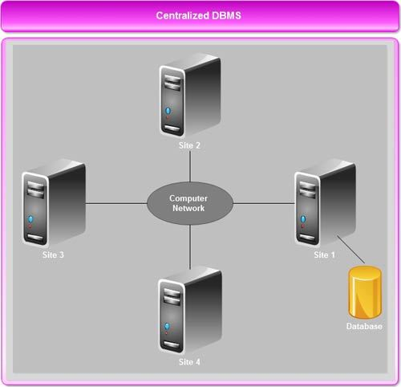
Fig. centralized database architecture

Slide 32
Client-Server Database Architecture
The client-server architecture has three components- the user interface programs, the application programs that contain the application logic and the DBMS that stores the data. The request made by the user interface program is processed using the application logic which then accesses the database to retrieve the data.
There are two kinds of Client-Server Database Architecture:
1) Two-tier Client-Server Architecture: In this architecture the user interface programs and the application programs run on the client side. An application program Interface(API) allows client side programs, to call the DBMS which is at the server side.
2) Three-tier Client-Server Architecture: In this architecture, in addition to the client and the database servers, it has an intermediate layer called Application Server or Web Server. The web server stores the application logic or business logic of the application. The client stores the user interface. The DBMS is stored at the server side. The web server interacts with client at one end, and with the server for the DBMS at the other end.

Slide 33
Advantages of client server database
better functionality for the cost
flexibility in locating resources and expanding facilities
better user interfaces
easier maintenance

Slide 34
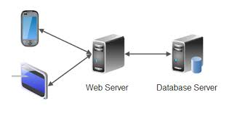
Fig Client-Server Database Architecture

Slide 35
Distributed Database Architecture
A distributed database is one with decentralized functionality of the DBMS. It is distributed among a number of computers. The computers that store the components of database are physically placed at different geographical locations.
Access to the distributed database is from remote locations via the communication links.
Features are:
Increased reliability and availability
Faster response for queries.
Better data and failure recovery.

Slide 36
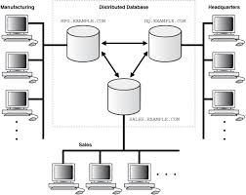
Fig Distributed Database Architecture

Slide 37
Database application
Databases range from those designed for a single user with a desktop computer to those on mainframe computers with thousands of users.
The database applications can be for different purposes like—
(1) personal databases that support one user with a stand-alone personal computer,
(2) workgroup databases for a small team of people (less than 25) who work in collaboration on a project,
(3) departmental databases designed to support the various functions and activities of a department (a functional unit of an organization), and
(4) enterprise databases to support organization-wide operations and decision making.

Slide 38
Data warehouse:
Data warehouse is an information system that contains historical and commutative data from single or multiple sources. It simplifies reporting and analysis process of the organization.
It is also a single version of truth for any company for decision making and forecasting.
Activities like delete, update, and insert which are performed in an operational application environment are omitted in Data warehouse environment. Only two types of data operations performed in the Data Warehousing are
Data loading
Data access

Slide 39
Characteristics of Data warehouse
A data warehouse has following characteristics:
Subject-Oriented
Integrated
Time-variant
Non-volatile

Slide 40
Advantages of Data warehouse:
More cost-effective decision-making: A data warehouse allows reduction of staff and computer resources required to support queries and reports against operational and production databases.
Better enterprise intelligence: Guaranteed data accuracy and reliability result from ensuring that a Data warehouse contains only “trusted data”.
Enhanced customer service: An enterprise can maintain better customer relationships by correlating all customer data through a single Data warehouse architecture.
Business reengineering: Knowing what information is important to an enterprise will provide direction and priority for reengineering efforts.
Information system reengineering: Data warehouse development can be an effective step in reengineering the enterprise’s legacy systems.

Slide 41
Disadvantages of Data warehouse:
Time Consuming Preparation
Data warehouse can be costly to maintain
Difficulty in Compatibility

Slide 42
Data Mining:
Data mining refers to extracting knowledge from large amount of data.
Data mining tools can answer business questions that traditionally were time consuming to resolve.
Data mining tools predict future trends and behaviors, allowing businesses to make proactive(practical), knowledge-driven decisions.

Slide 43
Why companies use data mining?
To perform market-basket analysis to identify new product bundles.
Find root causes of quality or manufacturing problems.
Prevent customer attrition and acquire new customers.
Cross-sell to existing customers.
Profile customers with more accuracy.

Slide 44
Big data
Big data is a term that describes the large volume of data – both structured and unstructured – that inundates (large) a business on a day-to-day basis. But it’s not the amount of data that’s important. It’s what organizations do with the data that matters. Big data can be analyzed for insights that lead to better decisions and strategic business moves.
An example of big data might be petabytes (1,024 terabytes) or exabytes (1,024 petabytes) of data consisting of billions to trillions of records of millions of people—all from different sources (e.g. Web, sales, customer contact center, social media, mobile data and so on).

Slide 45
Definition of big data as the three Vs:
Volume. Organizations collect data from a variety of sources, including business transactions, social media and information from sensor or machine-to-machine data. In the past, storing it would’ve been a problem – but new technologies have eased the burden.
Velocity. Data streams in at an unprecedented(extraordinary) speed and must be dealt with in a timely manner. RFID (Radio frequency identification) tags, sensors and smart metering are driving the need to deal with torrents of data in near-real time.
Variety. Data comes in all types of formats – from structured, numeric data in traditional databases to unstructured text documents, email, video, audio, stock ticker data and financial transactions.

Slide 46
*******The End *******

